Slide 1
JavaScript: Arrays
Arrays
Declaring and Allocating Arrays
Examples Using Arrays
Random Image Generator Using Arrays
References and Reference Parameters
Passing Arrays to Functions
Sorting Arrays
Searching Arrays: Linear Search and Binary Search
Multidimensional Arrays
Building an Online Quiz

Slide 2
Introduction
Arrays
  Data structures of related items
    Also called Collections
  Dynamic

Slide 3
Arrays
Arrays in JavaScript
  Each element referenced by a number
    Start at “zeroth element”
    Subscript or index
  Accessing a specific element
    Name of array
    Brackets
    Number of element
  Arrays know their length
    length property

Slide 4
Arrays
Name of array
c[ 0 ]
-45
c[ 1 ]
6
c[ 2 ]
0
c[ 3 ]
72
c[ 4 ]
1543
c[ 5 ]
-89
c[ 6 ]
0
c[ 7 ]
62
c[ 8 ]
-3
c[ 9 ]
1
Position number (index
or subscript) of the
c[ 10 ]
6453
c
element within array
c[ 11 ]
78

Slide 5
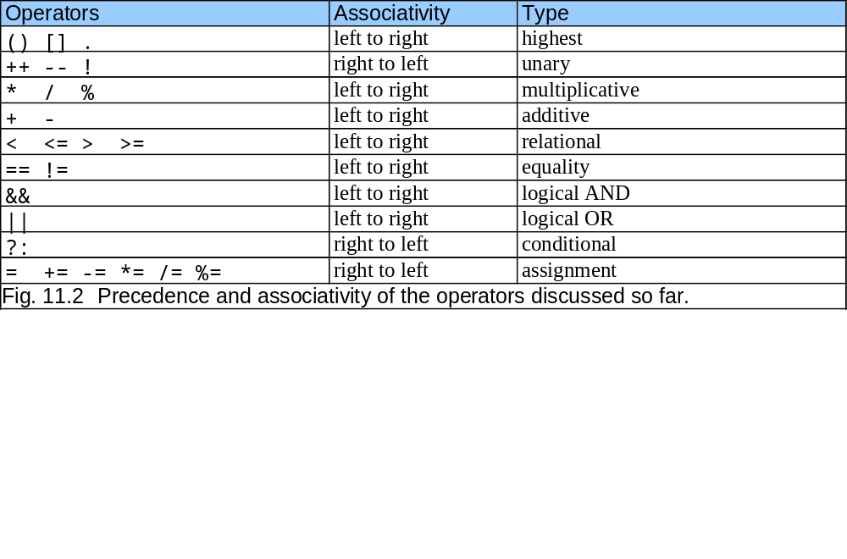
Arrays

Slide 6
Declaring and Allocating Arrays
Arrays in memory
  Objects
  Operator new
    Allocates memory for objects
    Dynamic memory allocation operator
    var c;
    c = new Array( 12 );

Slide 7
Examples Using Arrays
Arrays grow dynamically
  Allocate more space as items are added
Must initialize array elements
  Default value is undefined
  for loops convenient
  Referring to uninitialized elements or elements outside array bounds is an error

Slide 8
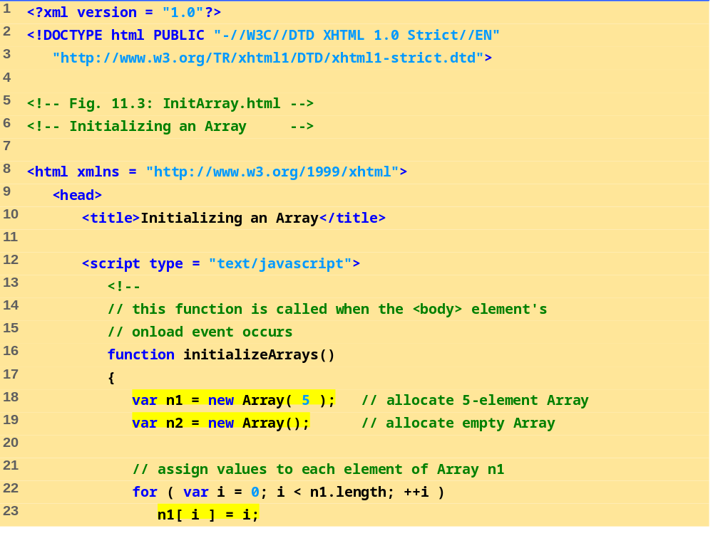

Slide 9
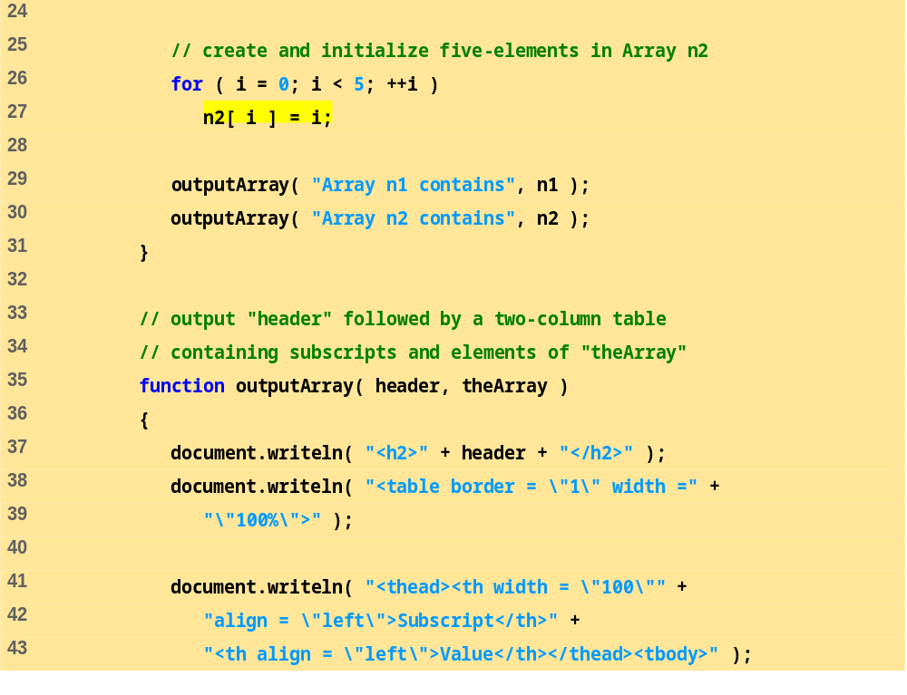

Slide 10
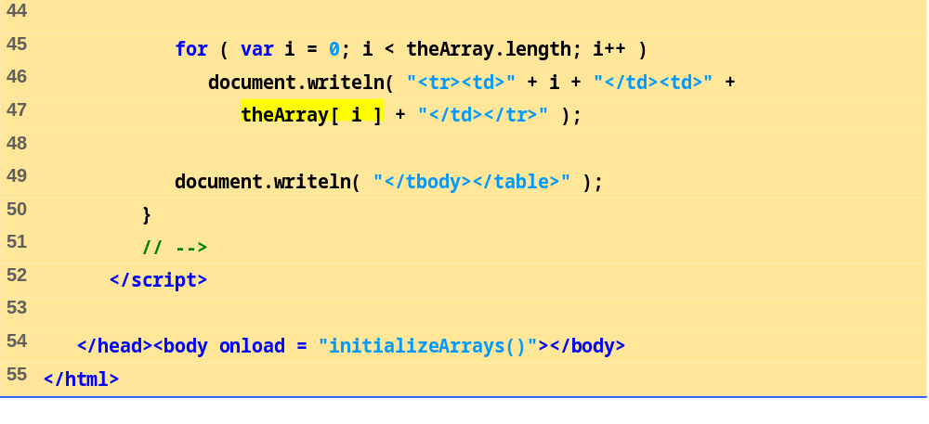

Slide 11
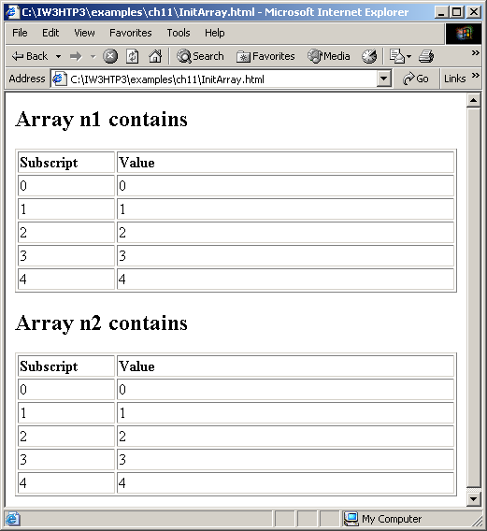
Examples Using Arrays

Slide 12
Examples Using Arrays
Possible to declare and initialize in one step
  Specify list of values
    Initializer list
  var n = [ 10, 20, 30, 40, 50 ];
  var n = new Array( 10, 20, 30, 40, 50 );
  Also possible to only initialize some values
    Leave uninitialized elements blank
    Uninitialized elements default to “undefined”
  var n = [ 10, 20, , 40, 50 ];

Slide 13
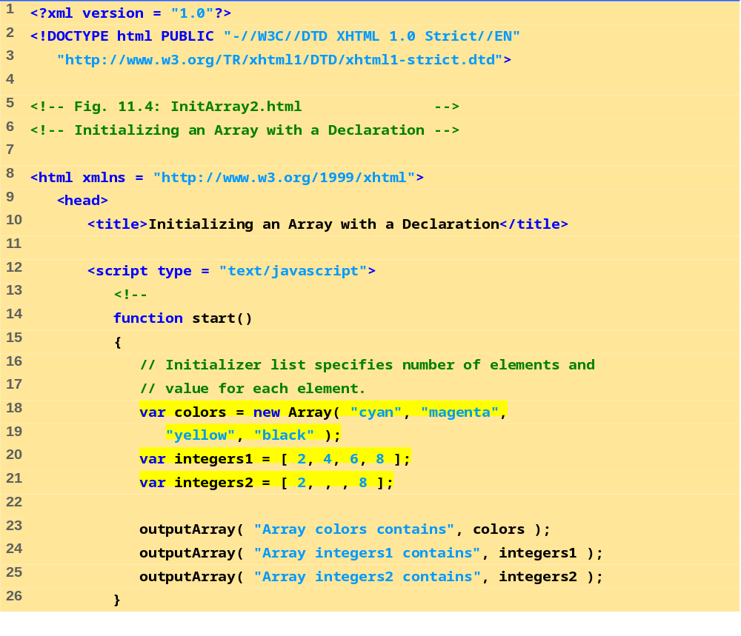

Slide 14
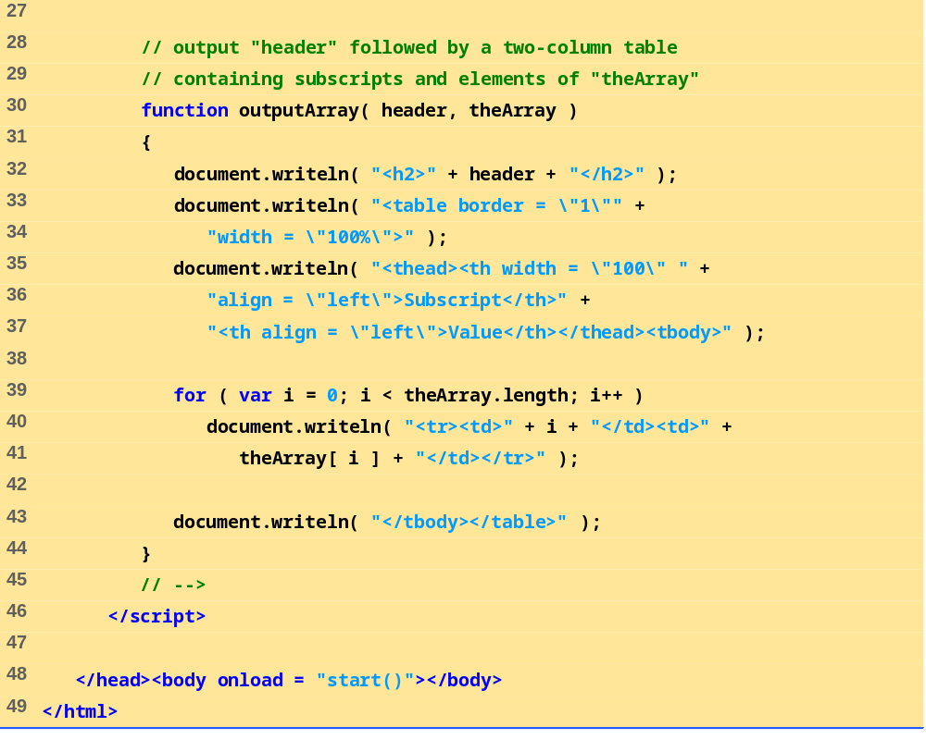

Slide 15
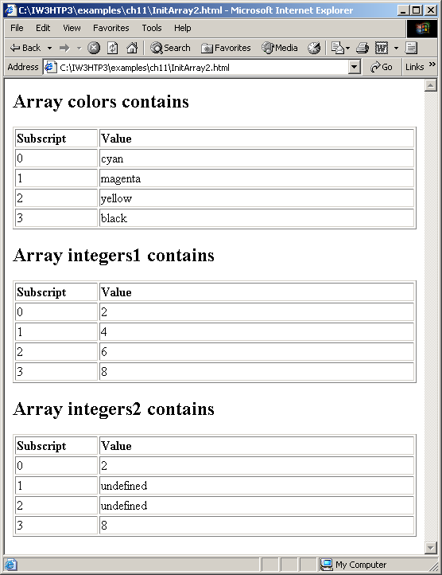
Examples Using Arrays

Slide 16
Examples Using Arrays
for…in statement
  Perform an action for each element in an array
  Iterates over array elements
    Assigns each element to specified variable one at a time
  Ignores non-existent elements

Slide 17
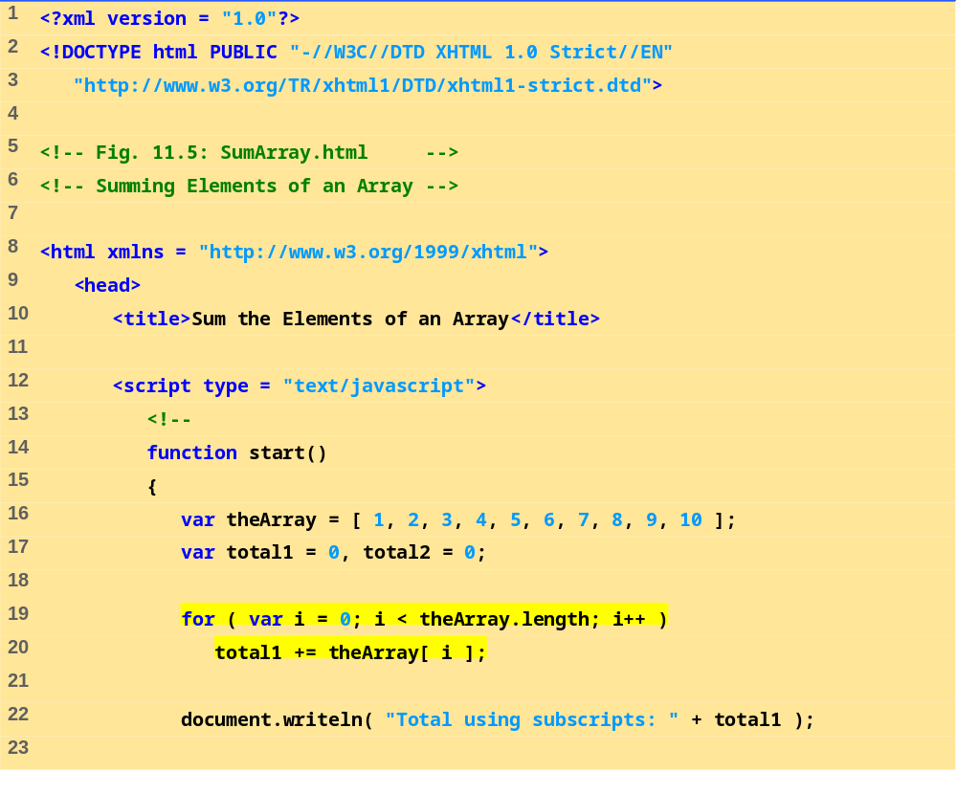

Slide 18
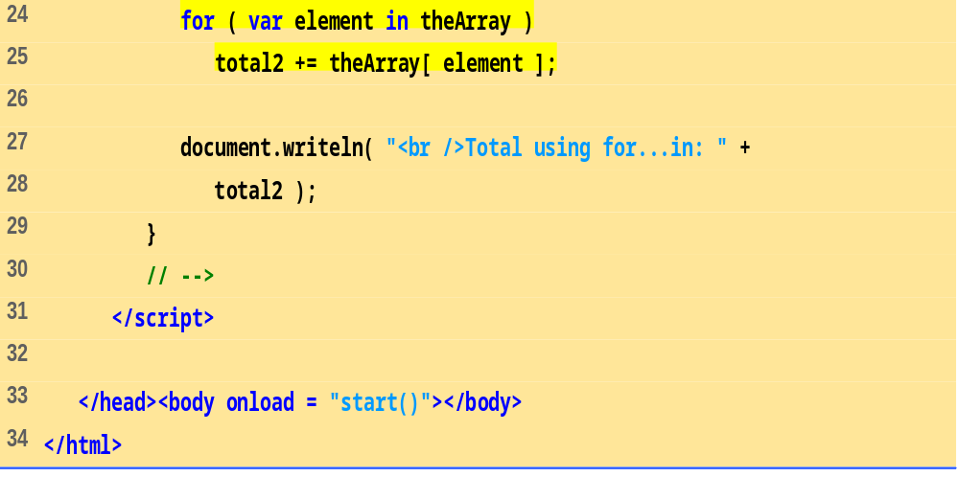

Slide 19
Examples Using Arrays

Slide 20
Examples Using Arrays
Arrays can provide shorter and cleaner substitute for switch statements
  Each element represents one case

Slide 21
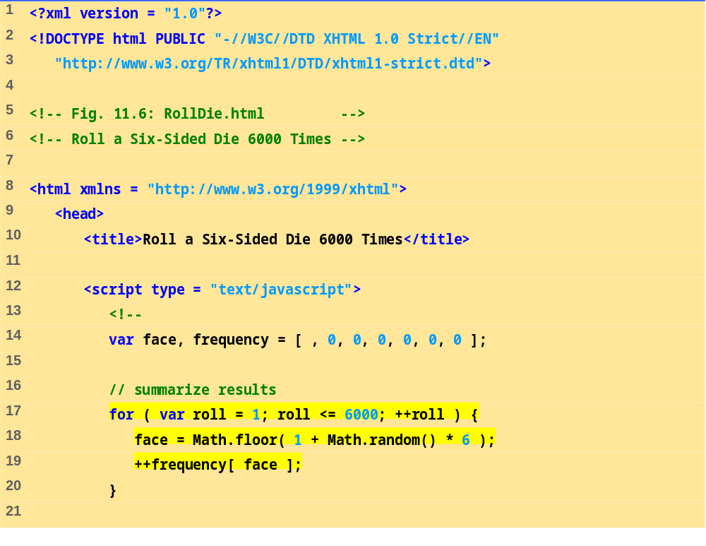

Slide 22
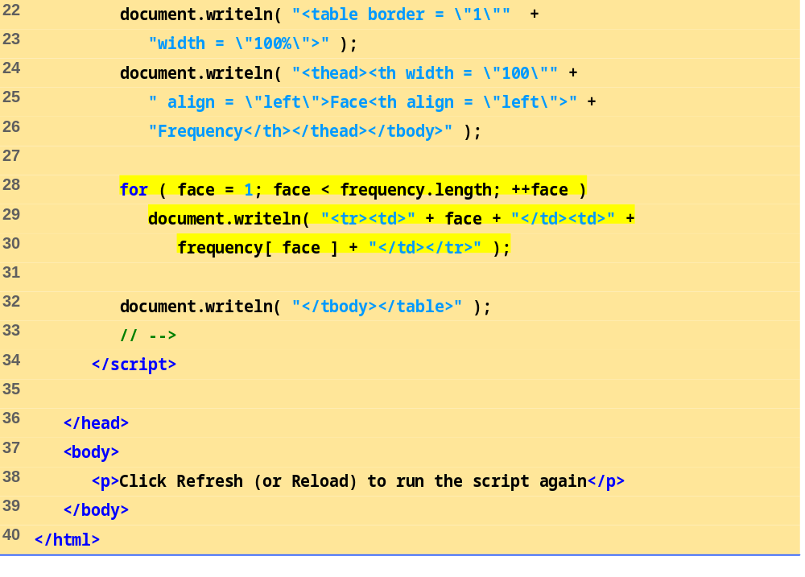

Slide 23
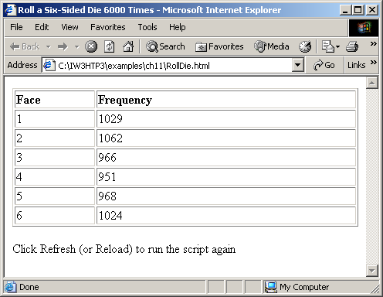
Examples Using Arrays

Slide 24
Random Image Generator Using Arrays
Cleaner approach than previous version
  Specify any file name rather than integers 1-7
  Result of Math.random call is index into array of image file names

Slide 25
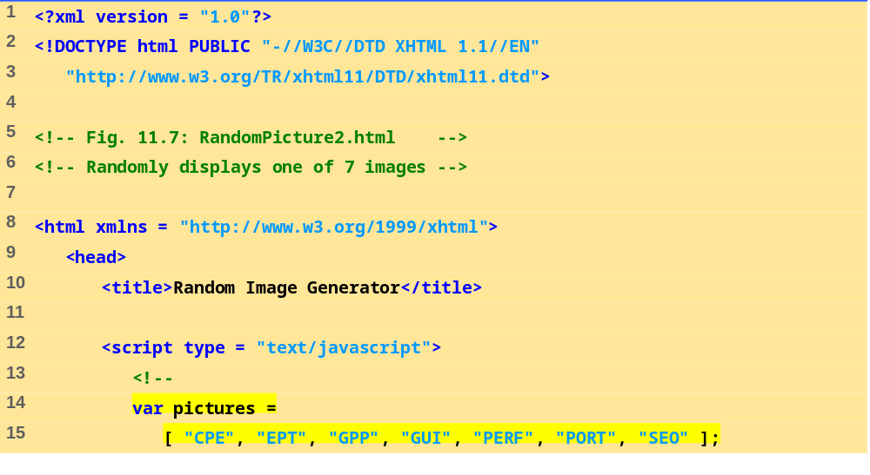
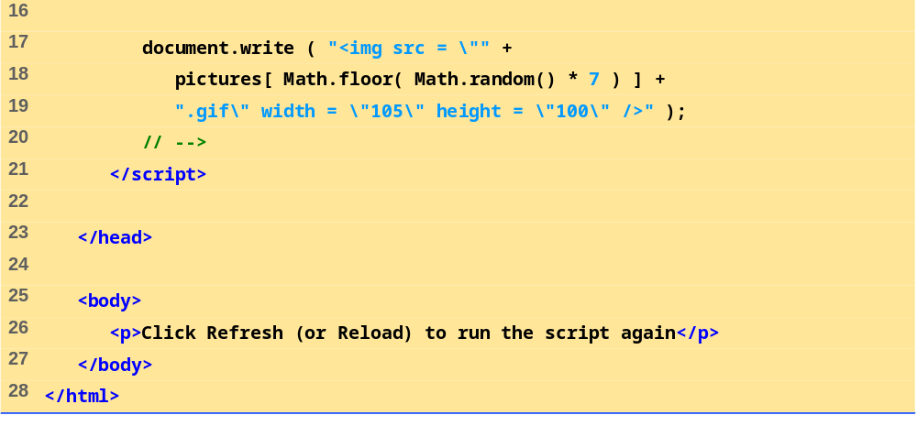

Slide 26
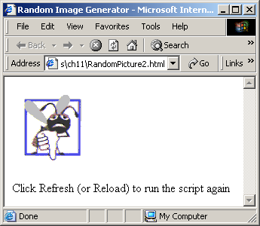
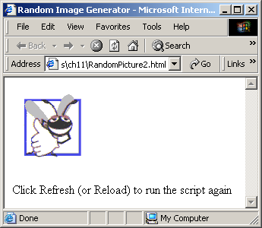
Random Image Generator Using Arrays

Slide 27
References and Reference Parameters
Two ways to pass parameters
  Pass-by-value
    Pass copy of original value
    Default for numbers and booleans
    Original variable is unchanged
  Pass-by-reference
    How objects are passed, like arrays
    Pass location in memory of value
    Allows direct access to original value
    Improves performance

Slide 28
Passing Arrays to Functions
Name of array is argument
  Not necessary to also pass size of array
    Arrays know their size
  Passed by reference
    Individual elements are passed by value if numbers or booleans
Array.join
  Creates string containing all array elements
  Specify separator

Slide 29
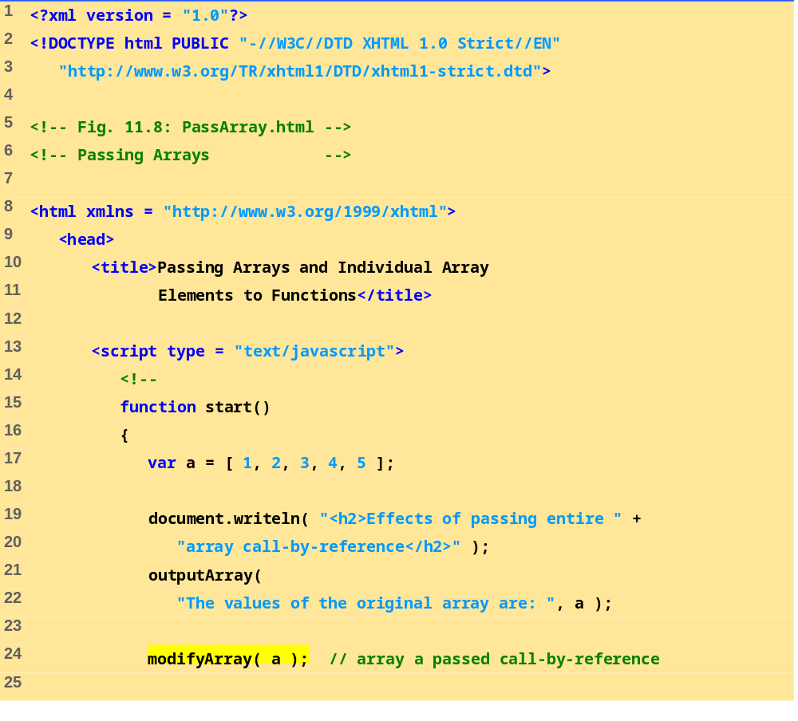

Slide 30
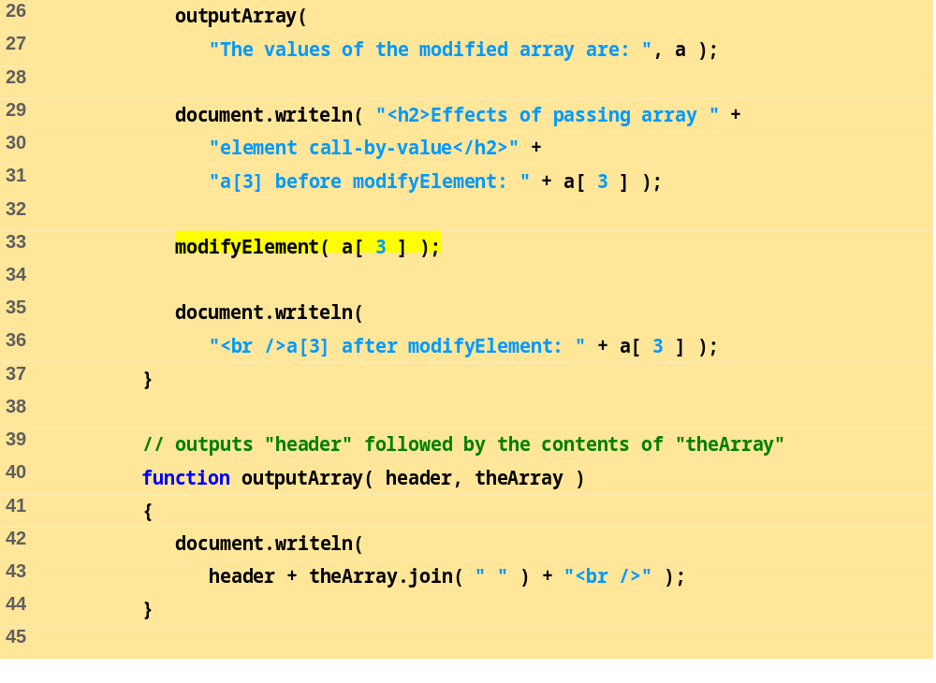

Slide 31
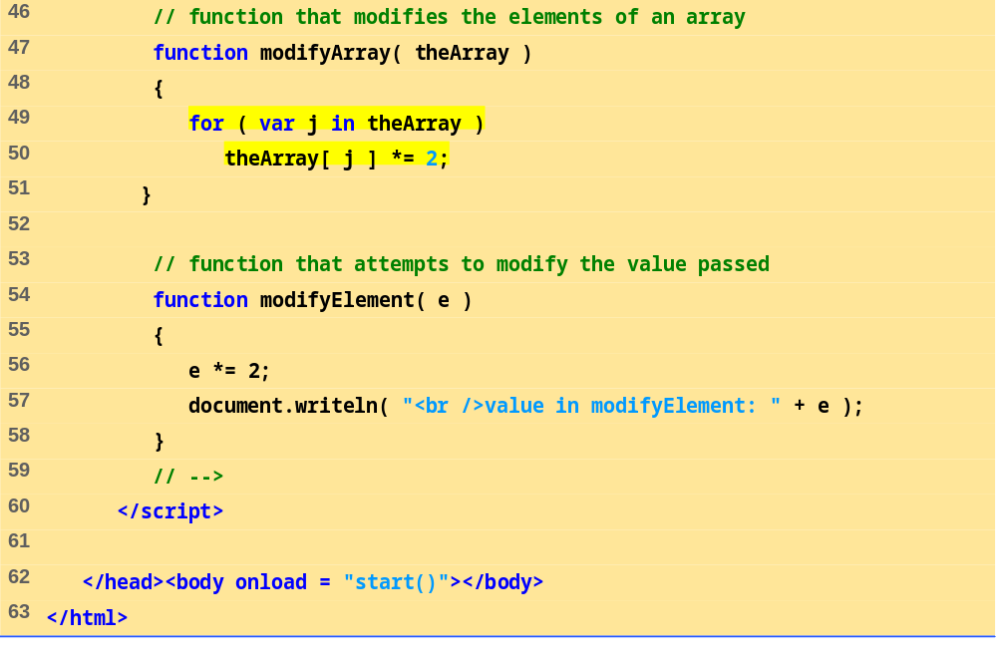

Slide 32
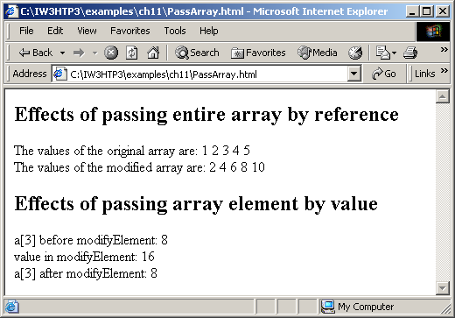
Passing Arrays to Functions

Slide 33
Sorting Arrays
Sorting
  Important computing task
Array.sort
  Defaults to string comparison
  Optional comparator function
    Return negative if first argument less than second
    Return zero if arguments equal
    Return positive if first argument greater than second

Slide 34
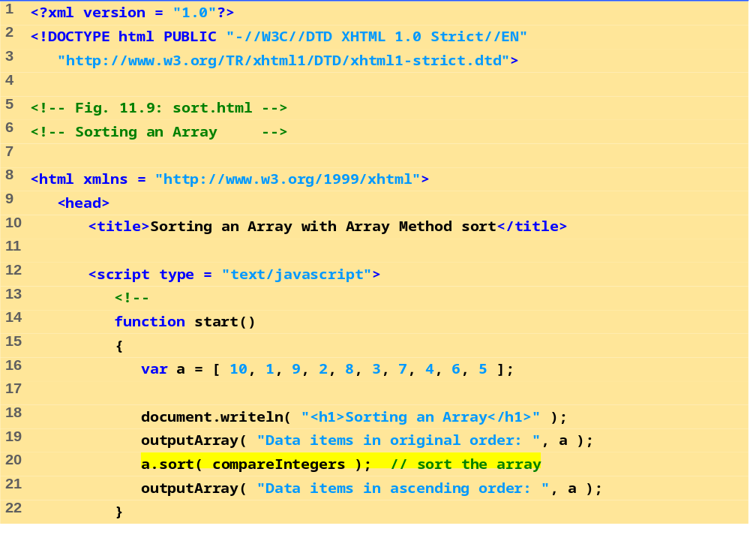

Slide 35
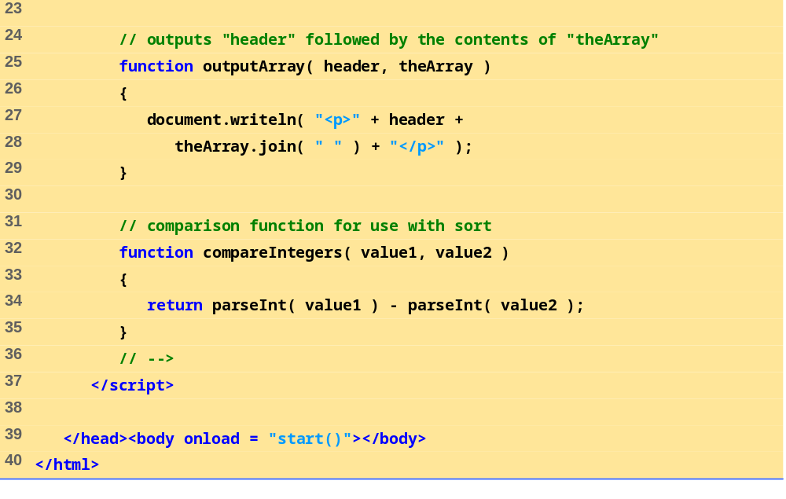

Slide 36
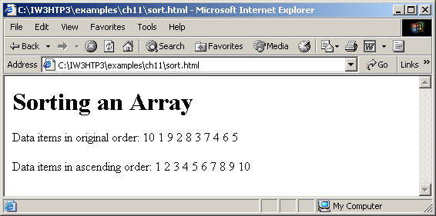
Sorting Arrays

Slide 37
Searching Arrays: Linear Search and Binary Search
Searching
  Look for matching key value
Linear search
  Iterate through each element until match found
  Inefficient
    Worst case scenario, must test entire array
Binary search
  Requires sorted data
  Cuts search range in half each iteration
  Efficient
    Only look at small fraction of elements

Slide 38
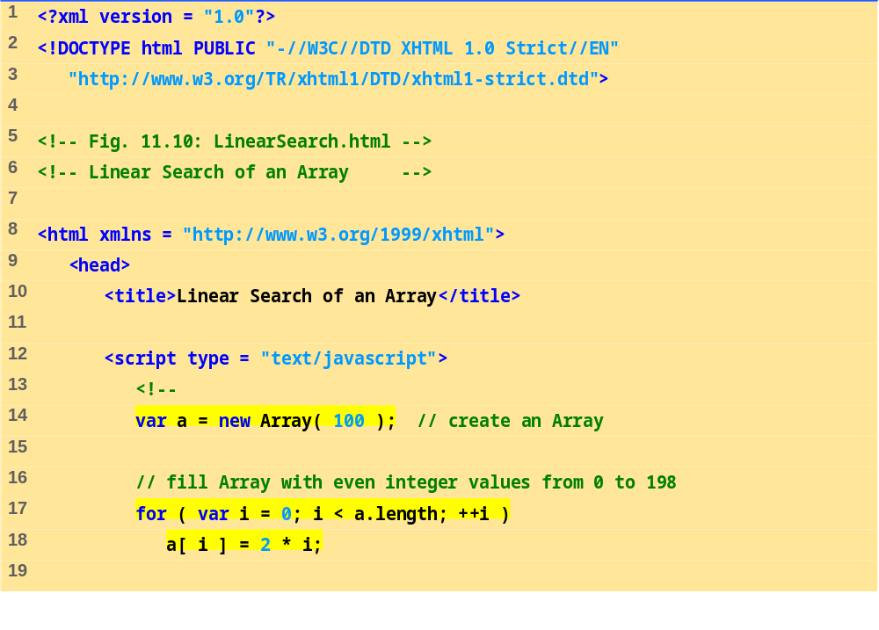

Slide 39
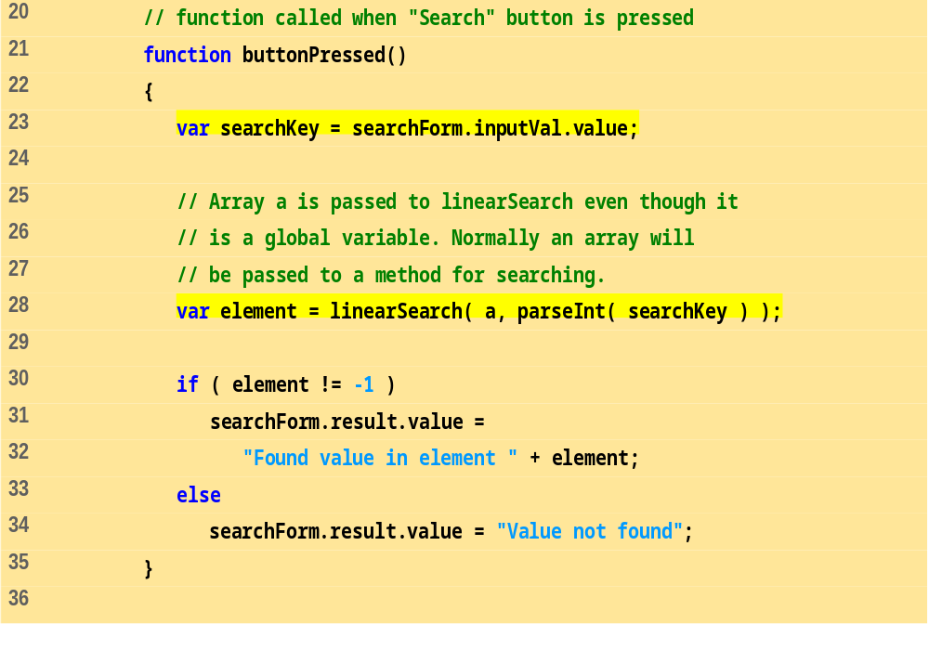

Slide 40
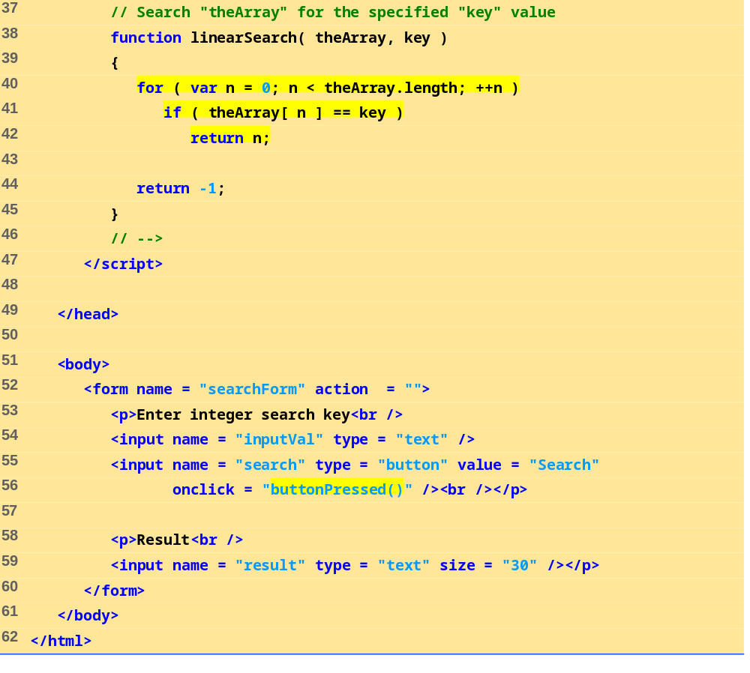

Slide 41
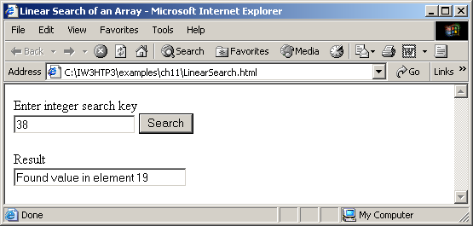
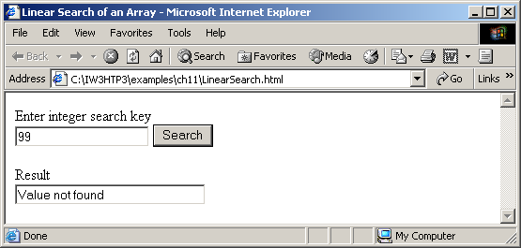
Searching Arrays: Linear Search and Binary Search

Slide 42
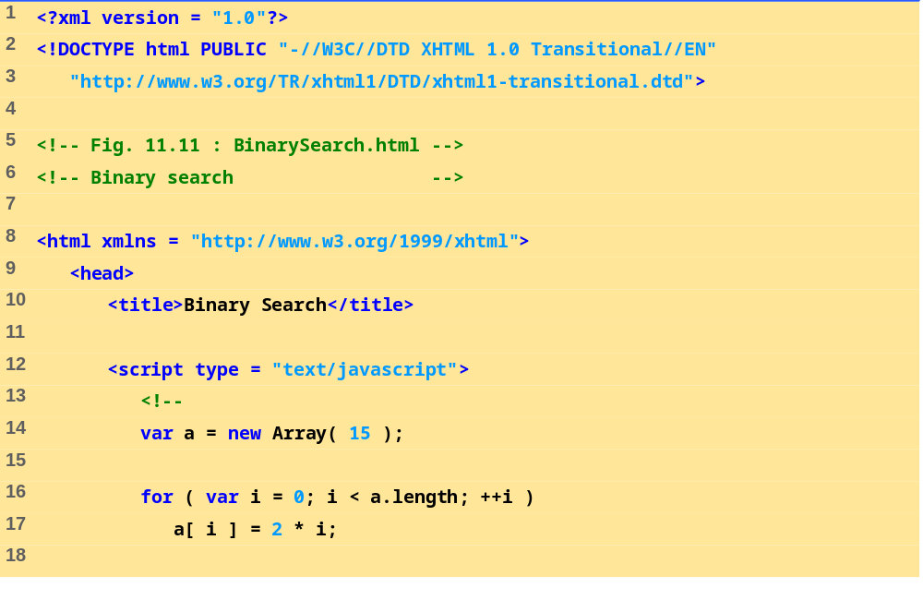

Slide 43
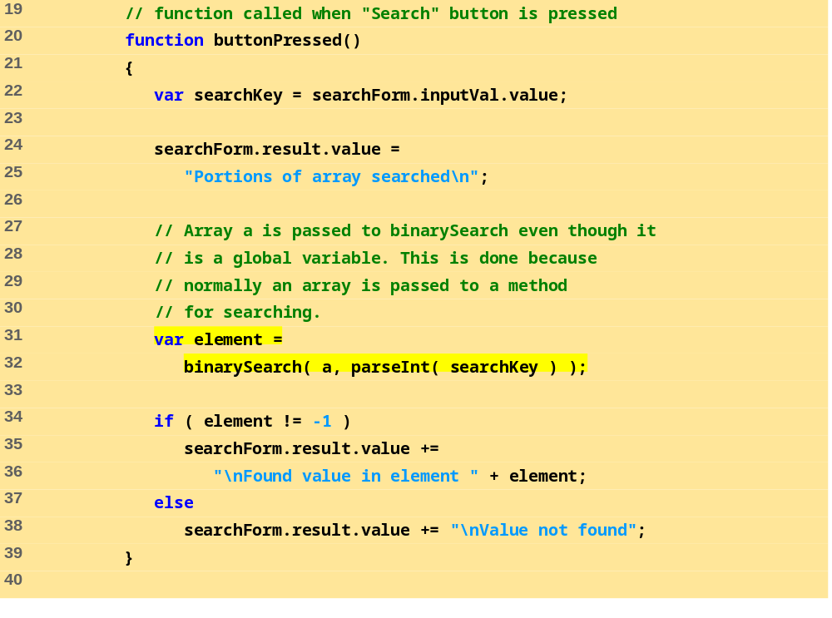

Slide 44
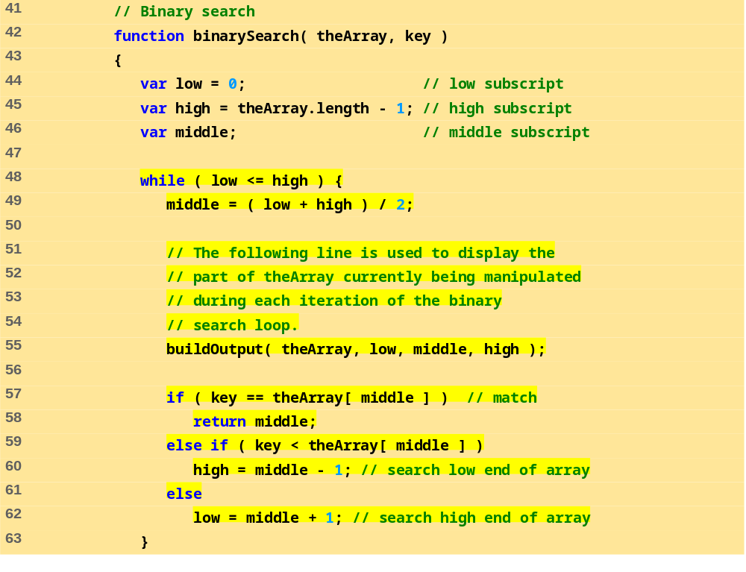

Slide 45
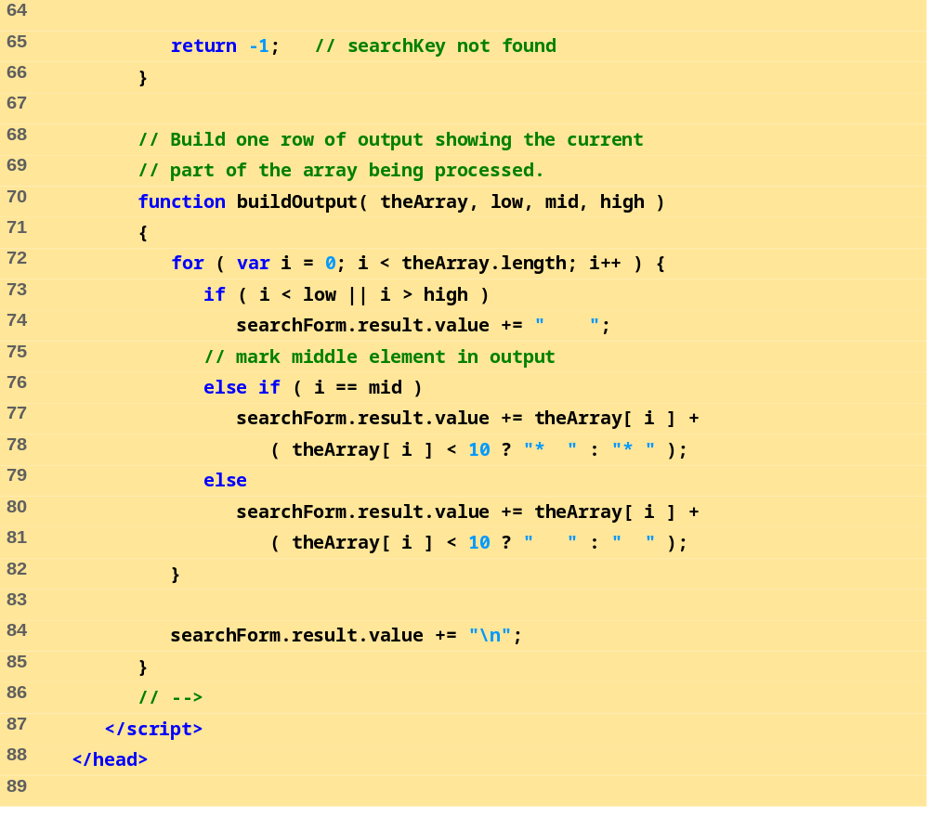

Slide 46
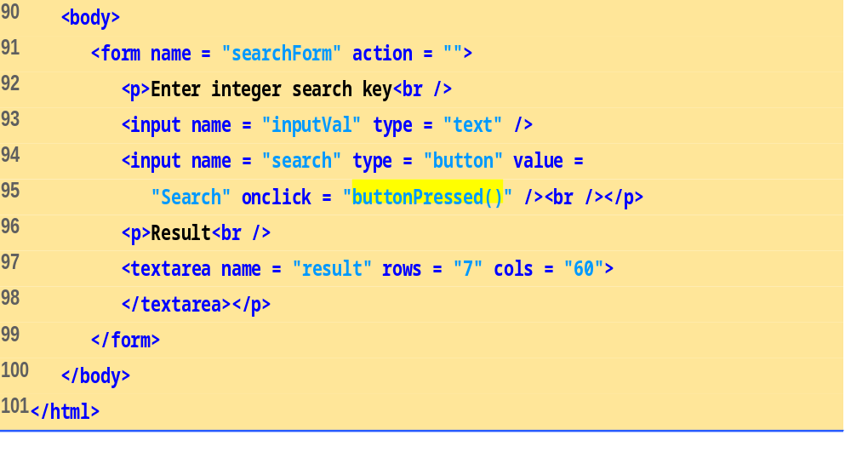

Slide 47
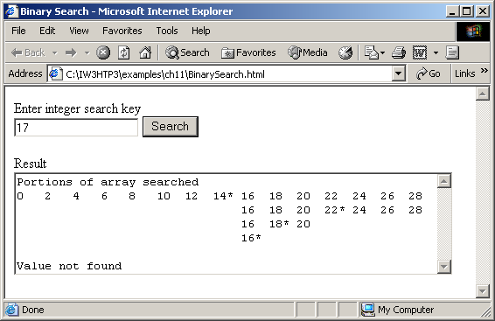
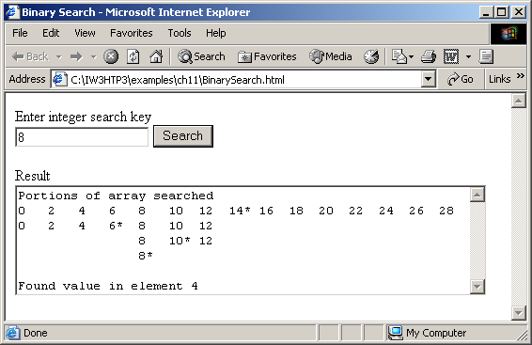
Searching Arrays: Linear Search and Binary Search

Slide 48
Multidimensional Arrays
Two-dimensional arrays analogous to tables
  Rows and columns
    Specify row first, then column
  Two subscripts

Slide 49
Multidimensional Arrays
Declaring and initializing multidimensional arrays
  Group by row in square brackets
  Treated as arrays of arrays
  Creating array b with one row of two elements and a second row of three elements:
  var b = [ [ 1, 2 ], [ 3, 4, 5 ] ];

Slide 50
Multidimensional Arrays
Also possible to use new operator
  Create array b with two rows, first with five columns and second with three:
var b;
b = new Array( 2 );
b[ 0 ] = new Array( 5 );
b[ 1 ] = new Array( 3 );

Slide 51
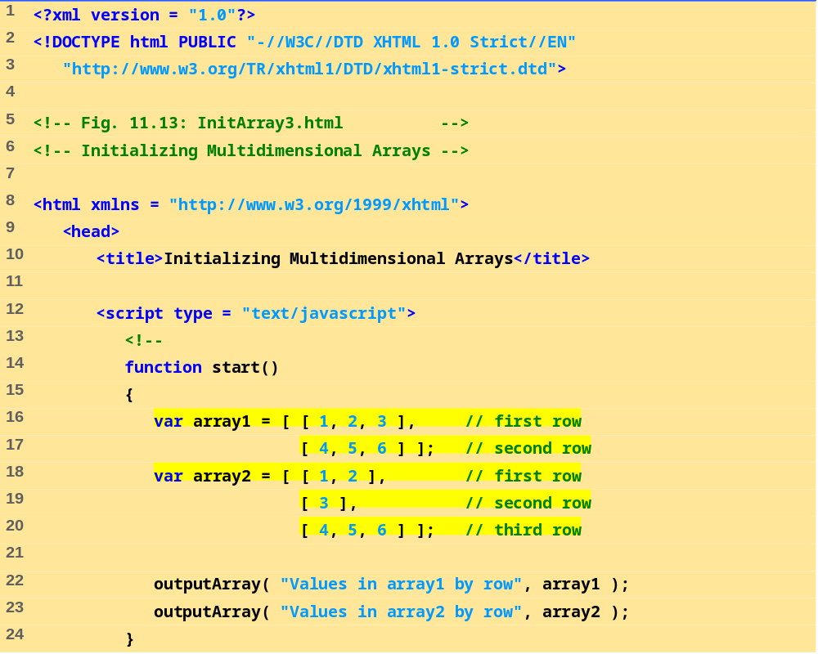

Slide 52
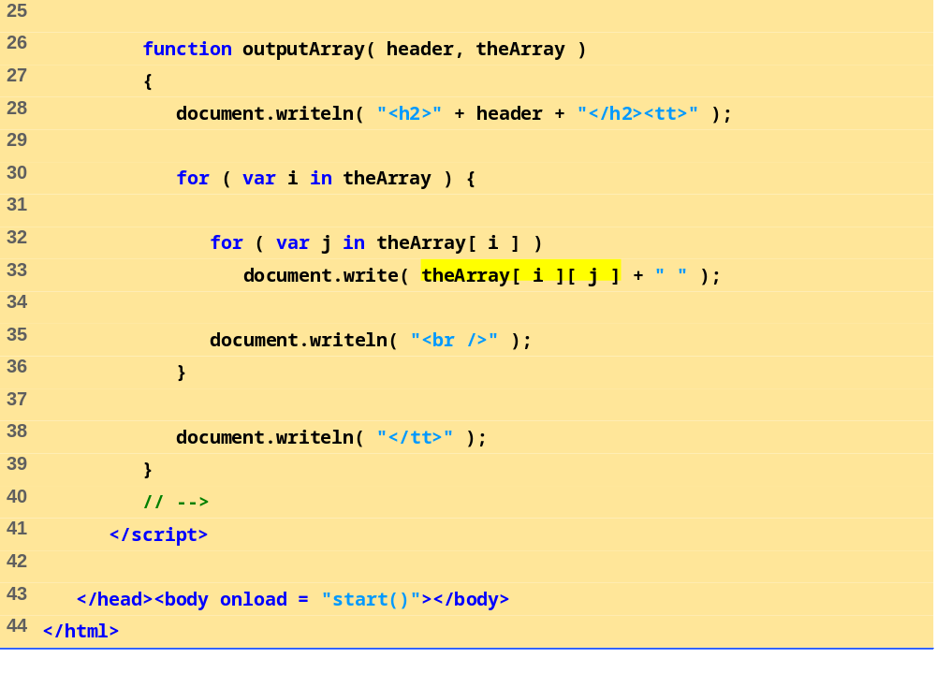

Slide 53
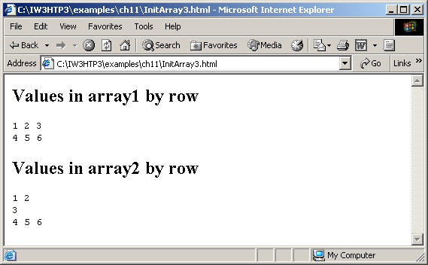
Multidimensional Arrays

Slide 54
Building an Online Quiz
Radio buttons
  Represented as an array
    Name of radio buttons is name of array
    One element per button
  checked property is true when selected
XHTML Forms
  Contain controls, including radio buttons
  action property specifies what happens when submitted
    Can call JavaScript code

Slide 55
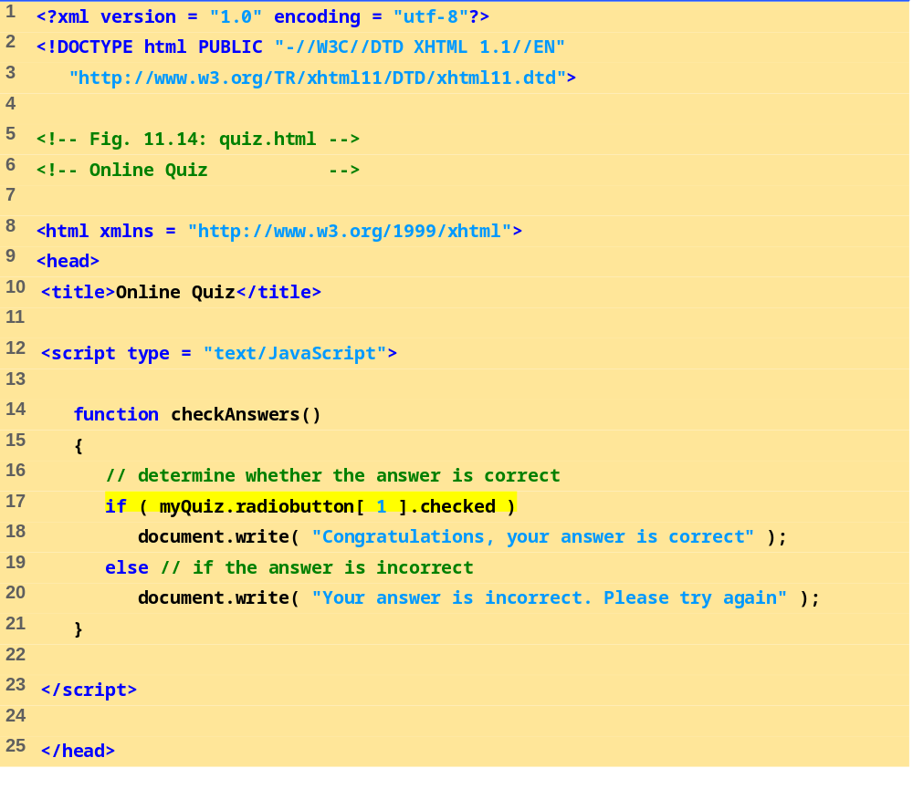

Slide 56
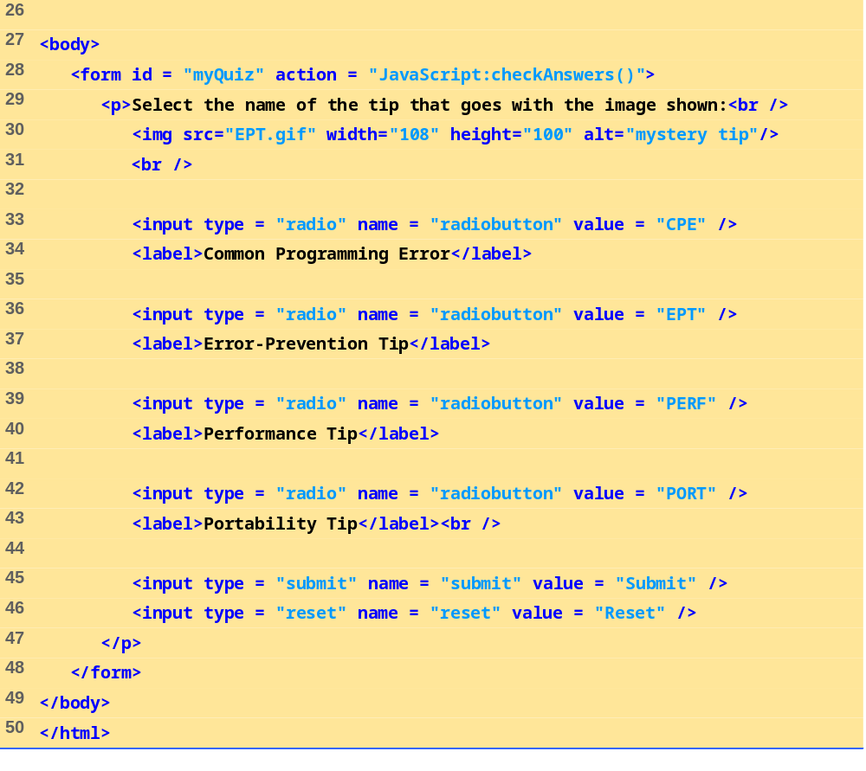

Slide 57
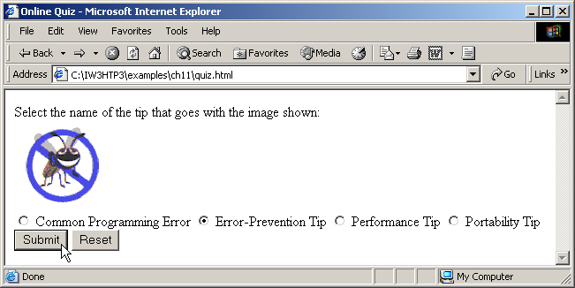
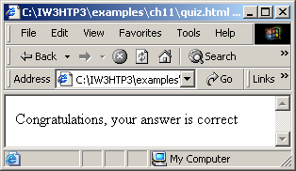
Building an Online Quiz

